Slide 1

What are higher order interactions and how can we measure them?
Andy Kleinhesselink¹
Jonathan M. Levine²
Nathan J.B. Kraft¹
¹Department of Ecology and Evolutionary Biology
UCLA
²Department of Ecology and Evolutionary Biology
Princeton University
Notes:
Thank you it’s great to be part of this session. And I’m glad so many of you stuck around this afternoon.

Slide 2
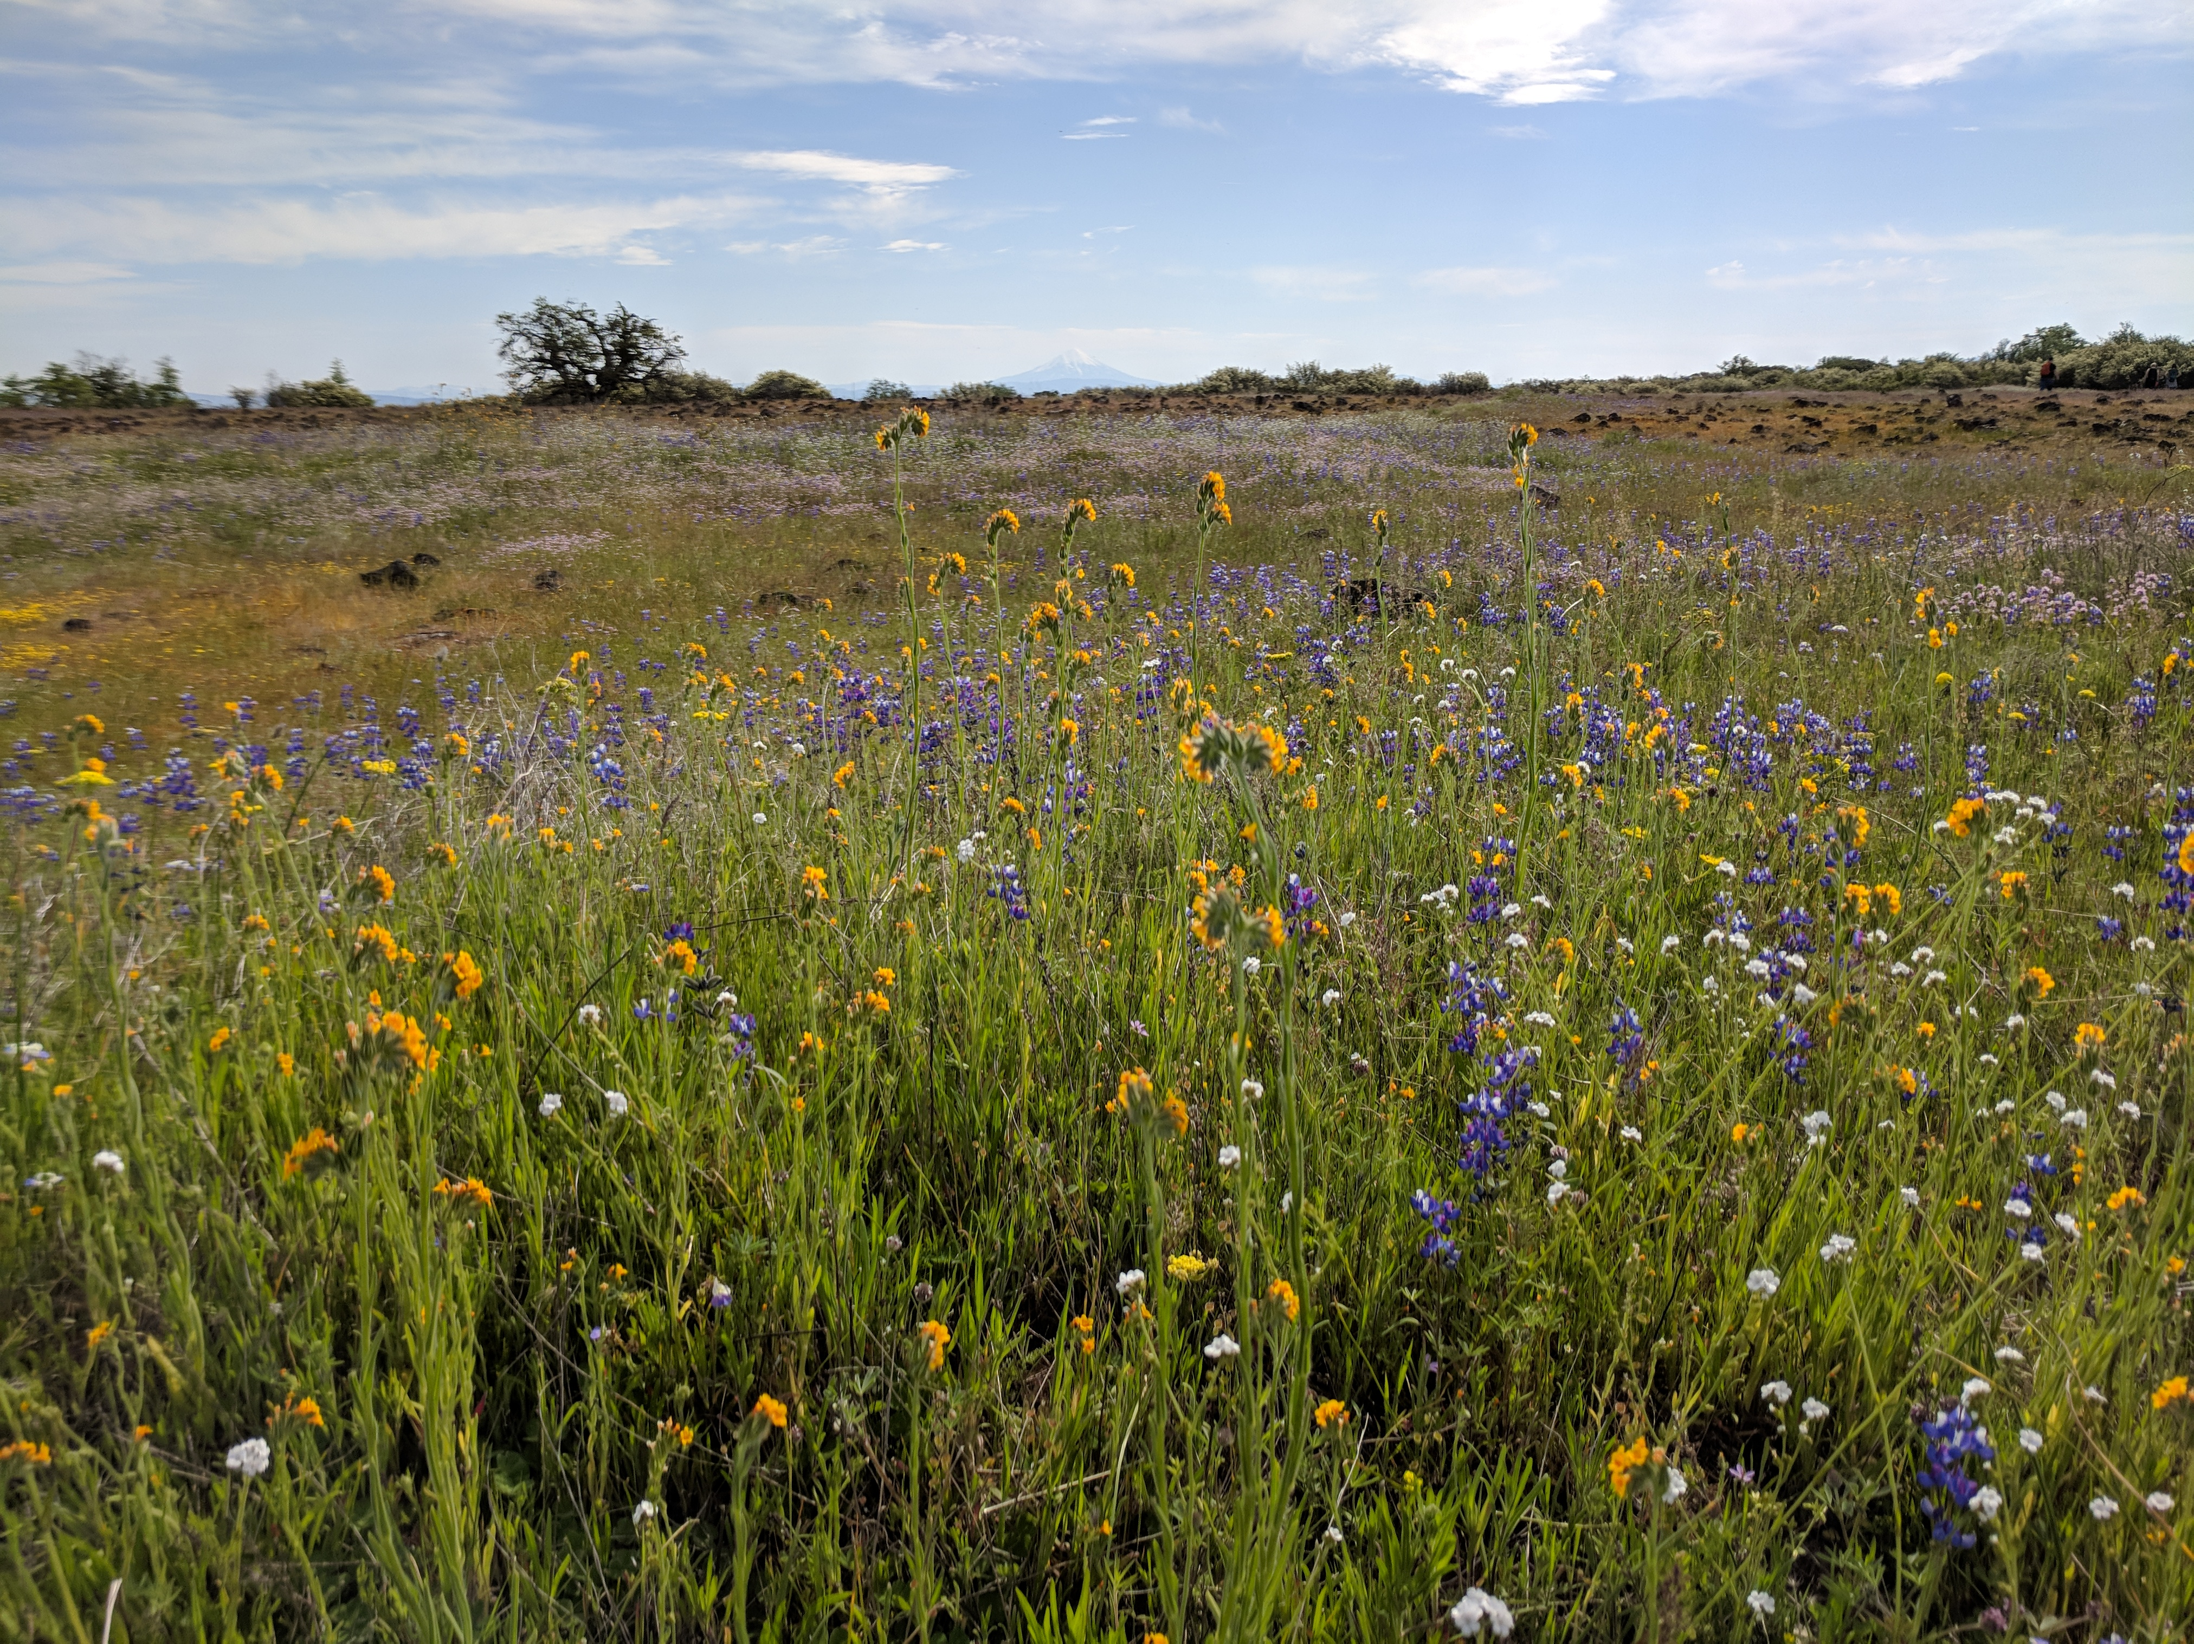
Notes:
An age old question in ecology is whether communities such as this are the sum of their parts—Does something new emerge when we put two, three, ten or twenty species together that isn’t there when the species are grown on their own.
On one hand we might hypothesize that if we only understand how each and every pair of species interacted in the community that would be enough for us to understand and predict the behavior of the entire multispecies community.
One the other hand, we might be skeptical of this reductionism: does understanding how each pair of species interact, leave something out when we put them together into a multi-species community?

Slide 3
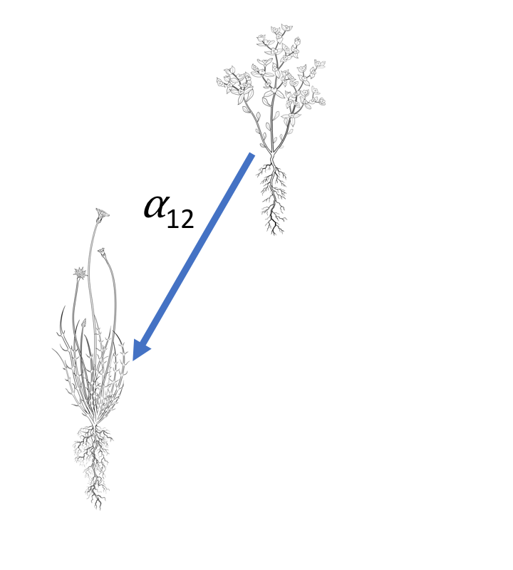
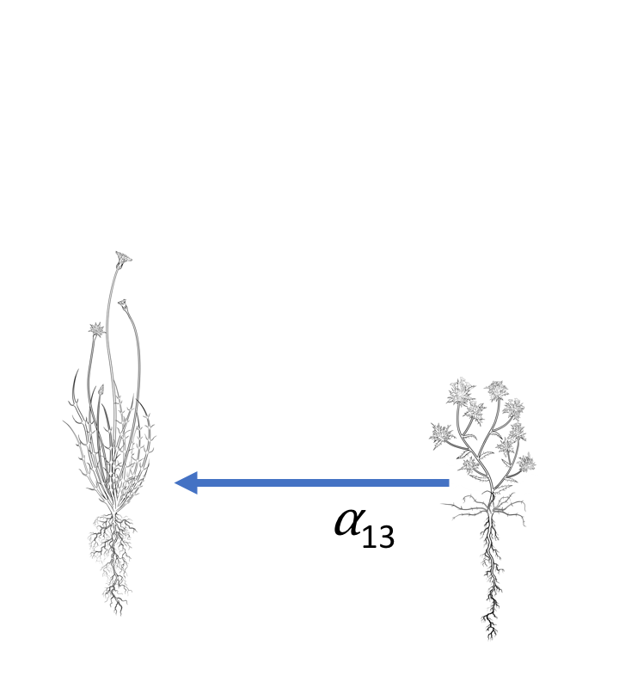
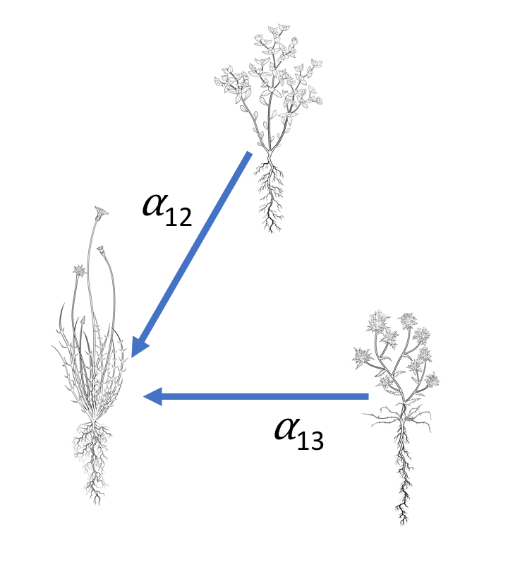
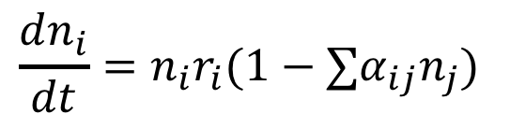
Competition models
Pairwise
Additive
$$\frac{dn_{i}}{dt}=n_{i}r_{i}(1−∑α_{ij}n_{j})$$
2
+
1
1
3
Illustrations, Joanna Shih
Notes:
We can get a more specific idea of what this question is all about when we consider a classical competition model such as the lotka-Volterra model.
Most competition models assume that competition is pairwise and additive. We parameterize models like this by observing how each species responds to density gradients of each other species growing. In the diagram we fit separate competition coefficients to describe the effect of species two on species one or the effect of species three on one.
If competition is truly pairwise and additive, we can predict from these separate situations how species one will respond to facing both species one and two together at once, we can simply add up the effects of two and three.

Slide 4
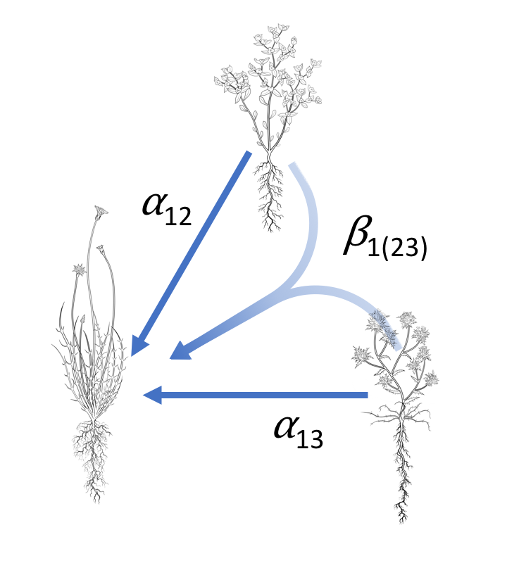
Higher order interactions
2
Not pairwise
Interaction modification
Non-additive
Emergence
HOI
1
3
Notes:
However, if interactions are non-additive, then we cannot predict the response of species one to species two and three together by simply adding up their separate effects.
If competition is non additive then there must be higher order interactions in the system non-additivity is to hypothesize that there are higher order interactions in the system.
That is the presence of two and three together somehow changes the dynamics of the system.
If higher order interactions are common in nature this presents a serious problem both practically and theoretically for community ecology. Practically it means that we cannot hope to understand multispecies communities with only pairwise interactions.
We need to run many, many more experiments in order to understand dynamical models that include higher order interactions.
Philosophically, it means that communities have emergent properties that cannot be easily reduced to pairwise interactions. And it argues for new theories of community ecology.

Slide 5
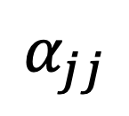
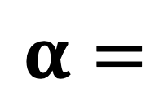
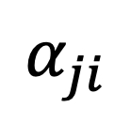
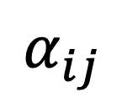
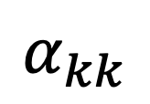
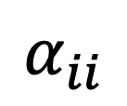
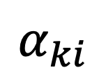
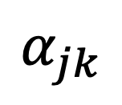

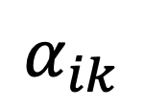

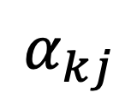
Why HOIs Matter
“Theory reduces the apparent complexity of the natural world…”^{[1]}
World without HOIs
World with HOIs
SIMPLE
COMPLEX
$$α_{ii}$$
$$α_{ij}$$
$$α_{ik}$$
$$α=m x m$$
$$α=$$
$$α_{ji}$$
$$α_{jj}$$
$$α_{jk}$$
$$β>m x m x m$$
$$α_{ki}$$
$$α_{kj}$$
$$α_{kk}$$
Marquet et al. 2014. On Theory in Ecology. Bioscience.

Slide 6
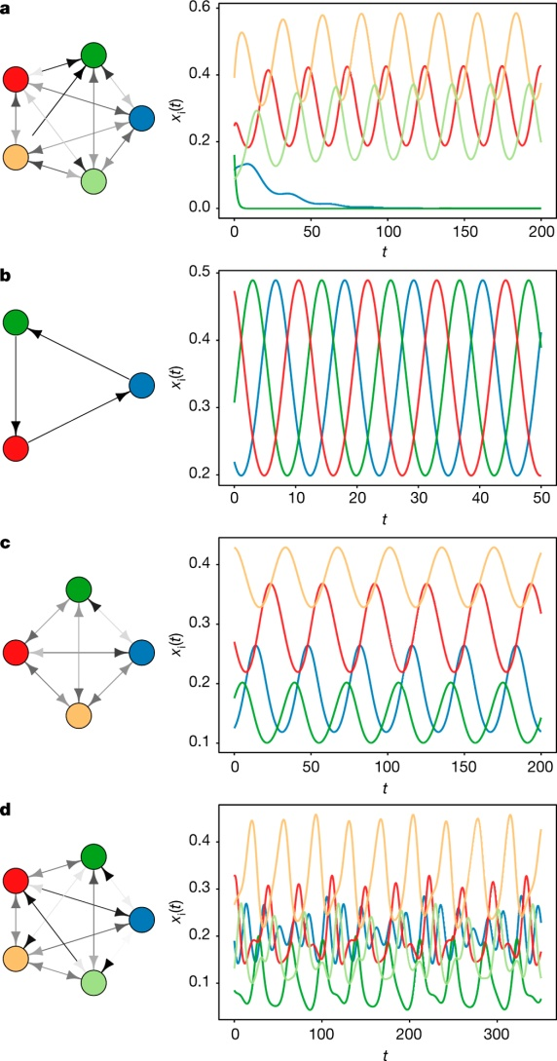
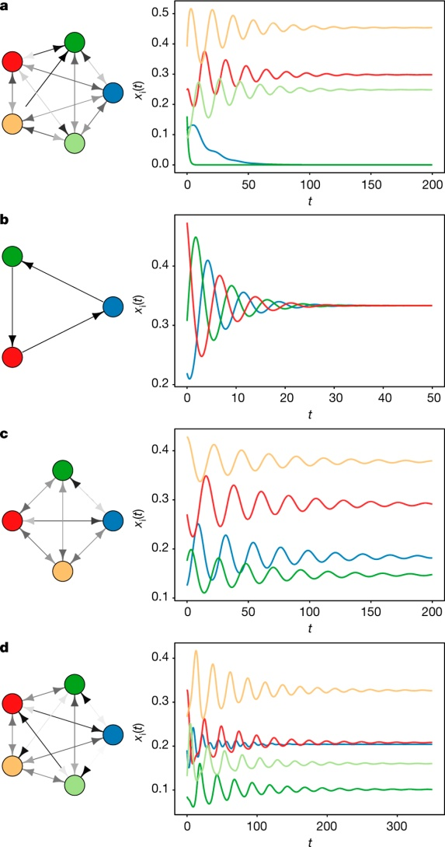
Why HOIs Matter: Emergence
Two species at a time
Three species at a time
J Grilli et al. Nature 1–4 (2017) doi:10.1038/nature23273

Slide 7
Questions
What counts as an HOI really?
Provide a new general definition of HOIs
How might HOIs arise in nature?
Simulate plant competition and fit HOI model
Notes:
The two main questions I’m going to address today, are first how can we detect higher order interactions?
And second, what sorts of mechanisms could produce higher order interactions among competing species?
This second question is focused mostly at competing plants. Among animals we know that higher order interactions can emerge due to changes in behavior of animals in multispecies communities. However, ecologists haven’t developed similar explanations for plants, and there is very little empirical evidence for or against higher order interactions among competing plants.

Slide 8
Questions
What counts as an HOI really?
Provide a new general definition of HOIs
How might HOIs arise in nature?
Simulate plant competition and fit HOI model
Notes:
Since, there is are so few empirical data to work with, our approach here was to first
Simulate some artificial plant communities using a mechanistic but very simplified model of species competition, that assumes nothing about higher order interactions.
Fit additive competition models to all the simulations involving pairwise competition.
Using the fitted additive competition models, we will then predict the effects of multispecies competition.
Finally we can evaluate the presence of higher order interactions by comparing the response to competition predicted by the additive models to the response “observed” in the simulation

Slide 9
What are HOIs?
Many different definitions!
Non additive interactions:
Interaction modification:
Non-linear density dependence:
Indirect effects:
Billick and Case. 1994.
Adler and Morris 1994.
Mayfield and Stouffer. 2017.
Grilli et al. 2017.
Notes:
However, if interactions are non-additive, then we cannot predict the response of species one to species two and three together by simply adding up their separate effects.
If competition is non additive then there must be higher order interactions in the system non-additivity is to hypothesize that there are higher order interactions in the system.
That is the presence of two and three together somehow changes the dynamics of the system.
If higher order interactions are common in nature this presents a serious problem both practically and theoretically for community ecology. Practically it means that we cannot hope to understand multispecies communities with only pairwise interactions.
We need to run many, many more experiments in order to understand dynamical models that include higher order interactions.
Philosophically, it means that communities have emergent properties that cannot be easily reduced to pairwise interactions. And it argues for new theories of community ecology.

Slide 10
What are HOIs?
Many different definitions!
Non additive interactions:
Interaction modification:
Non-linear density dependence:
Indirect effects:
General definition
Notes:
However, if interactions are non-additive, then we cannot predict the response of species one to species two and three together by simply adding up their separate effects.
If competition is non additive then there must be higher order interactions in the system non-additivity is to hypothesize that there are higher order interactions in the system.
That is the presence of two and three together somehow changes the dynamics of the system.
If higher order interactions are common in nature this presents a serious problem both practically and theoretically for community ecology. Practically it means that we cannot hope to understand multispecies communities with only pairwise interactions.
We need to run many, many more experiments in order to understand dynamical models that include higher order interactions.
Philosophically, it means that communities have emergent properties that cannot be easily reduced to pairwise interactions. And it argues for new theories of community ecology.

Slide 11
Questions
What counts as an HOI really?
Provide a new general definition of HOIs
How might HOIs arise in nature?
Simulate plant competition and fit HOI model
Notes:
Since, there is are so few empirical data to work with, our approach here was to first
Simulate some artificial plant communities using a mechanistic but very simplified model of species competition, that assumes nothing about higher order interactions.
Fit additive competition models to all the simulations involving pairwise competition.
Using the fitted additive competition models, we will then predict the effects of multispecies competition.
Finally we can evaluate the presence of higher order interactions by comparing the response to competition predicted by the additive models to the response “observed” in the simulation

Slide 12
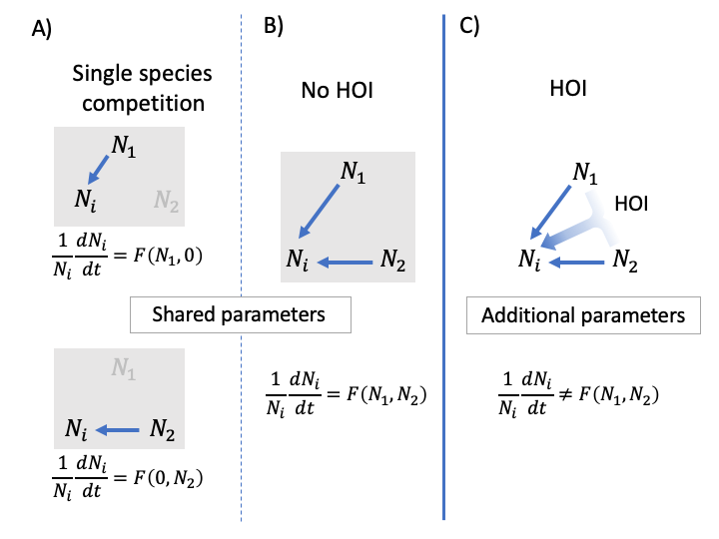
A general definition for HOIs
Kleinhesselink, Kraft and Levine. In prep.
Notes:
As I said earlier, HOIs result from interaction modification. But we need to dig into this more

Slide 13
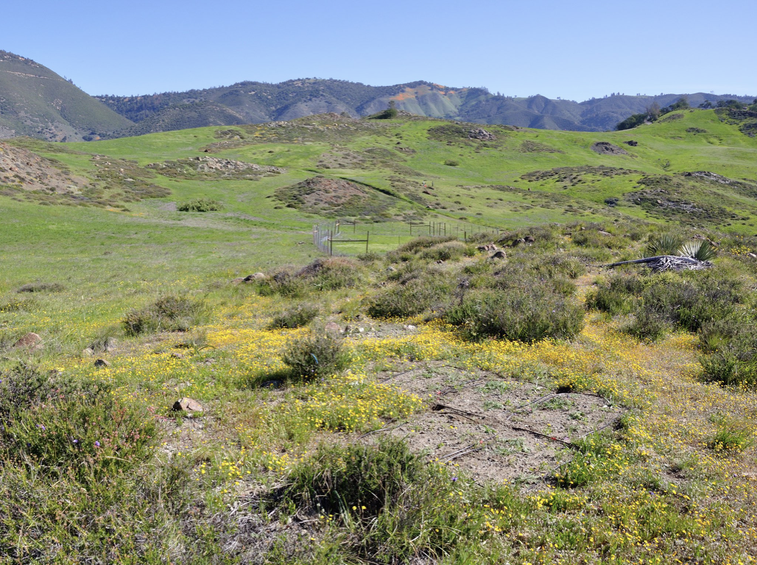
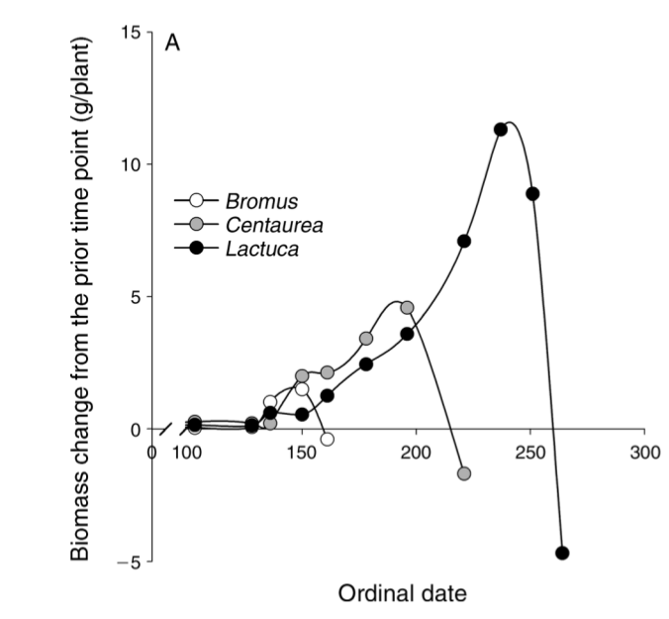
California annual plants
Godoy and Levine (2014)
Notes:
The simulation model we developed is inspired by the life history of California annual plants.
In California the rainfall is restricted to the winter and early spring.
This means annual plants have a very limited window of time when soil resources are sufficient for growth, basically from late winter into spring, and then in the summer things get too dry and all the plants flower and senesce.
This figure from work by Oscar Gody and Jonathan Levine shows the typical growth trajectory of three annual plant species over the course of a growing season.
You can see that these species each reach a point during the year where the stop growing, and this is a species specific traits.
The species shown in white grows early and then stops growing at about day 150.
While the species shown in black is a late season species that grows late into the summer and stops growing at day 250.

Slide 14
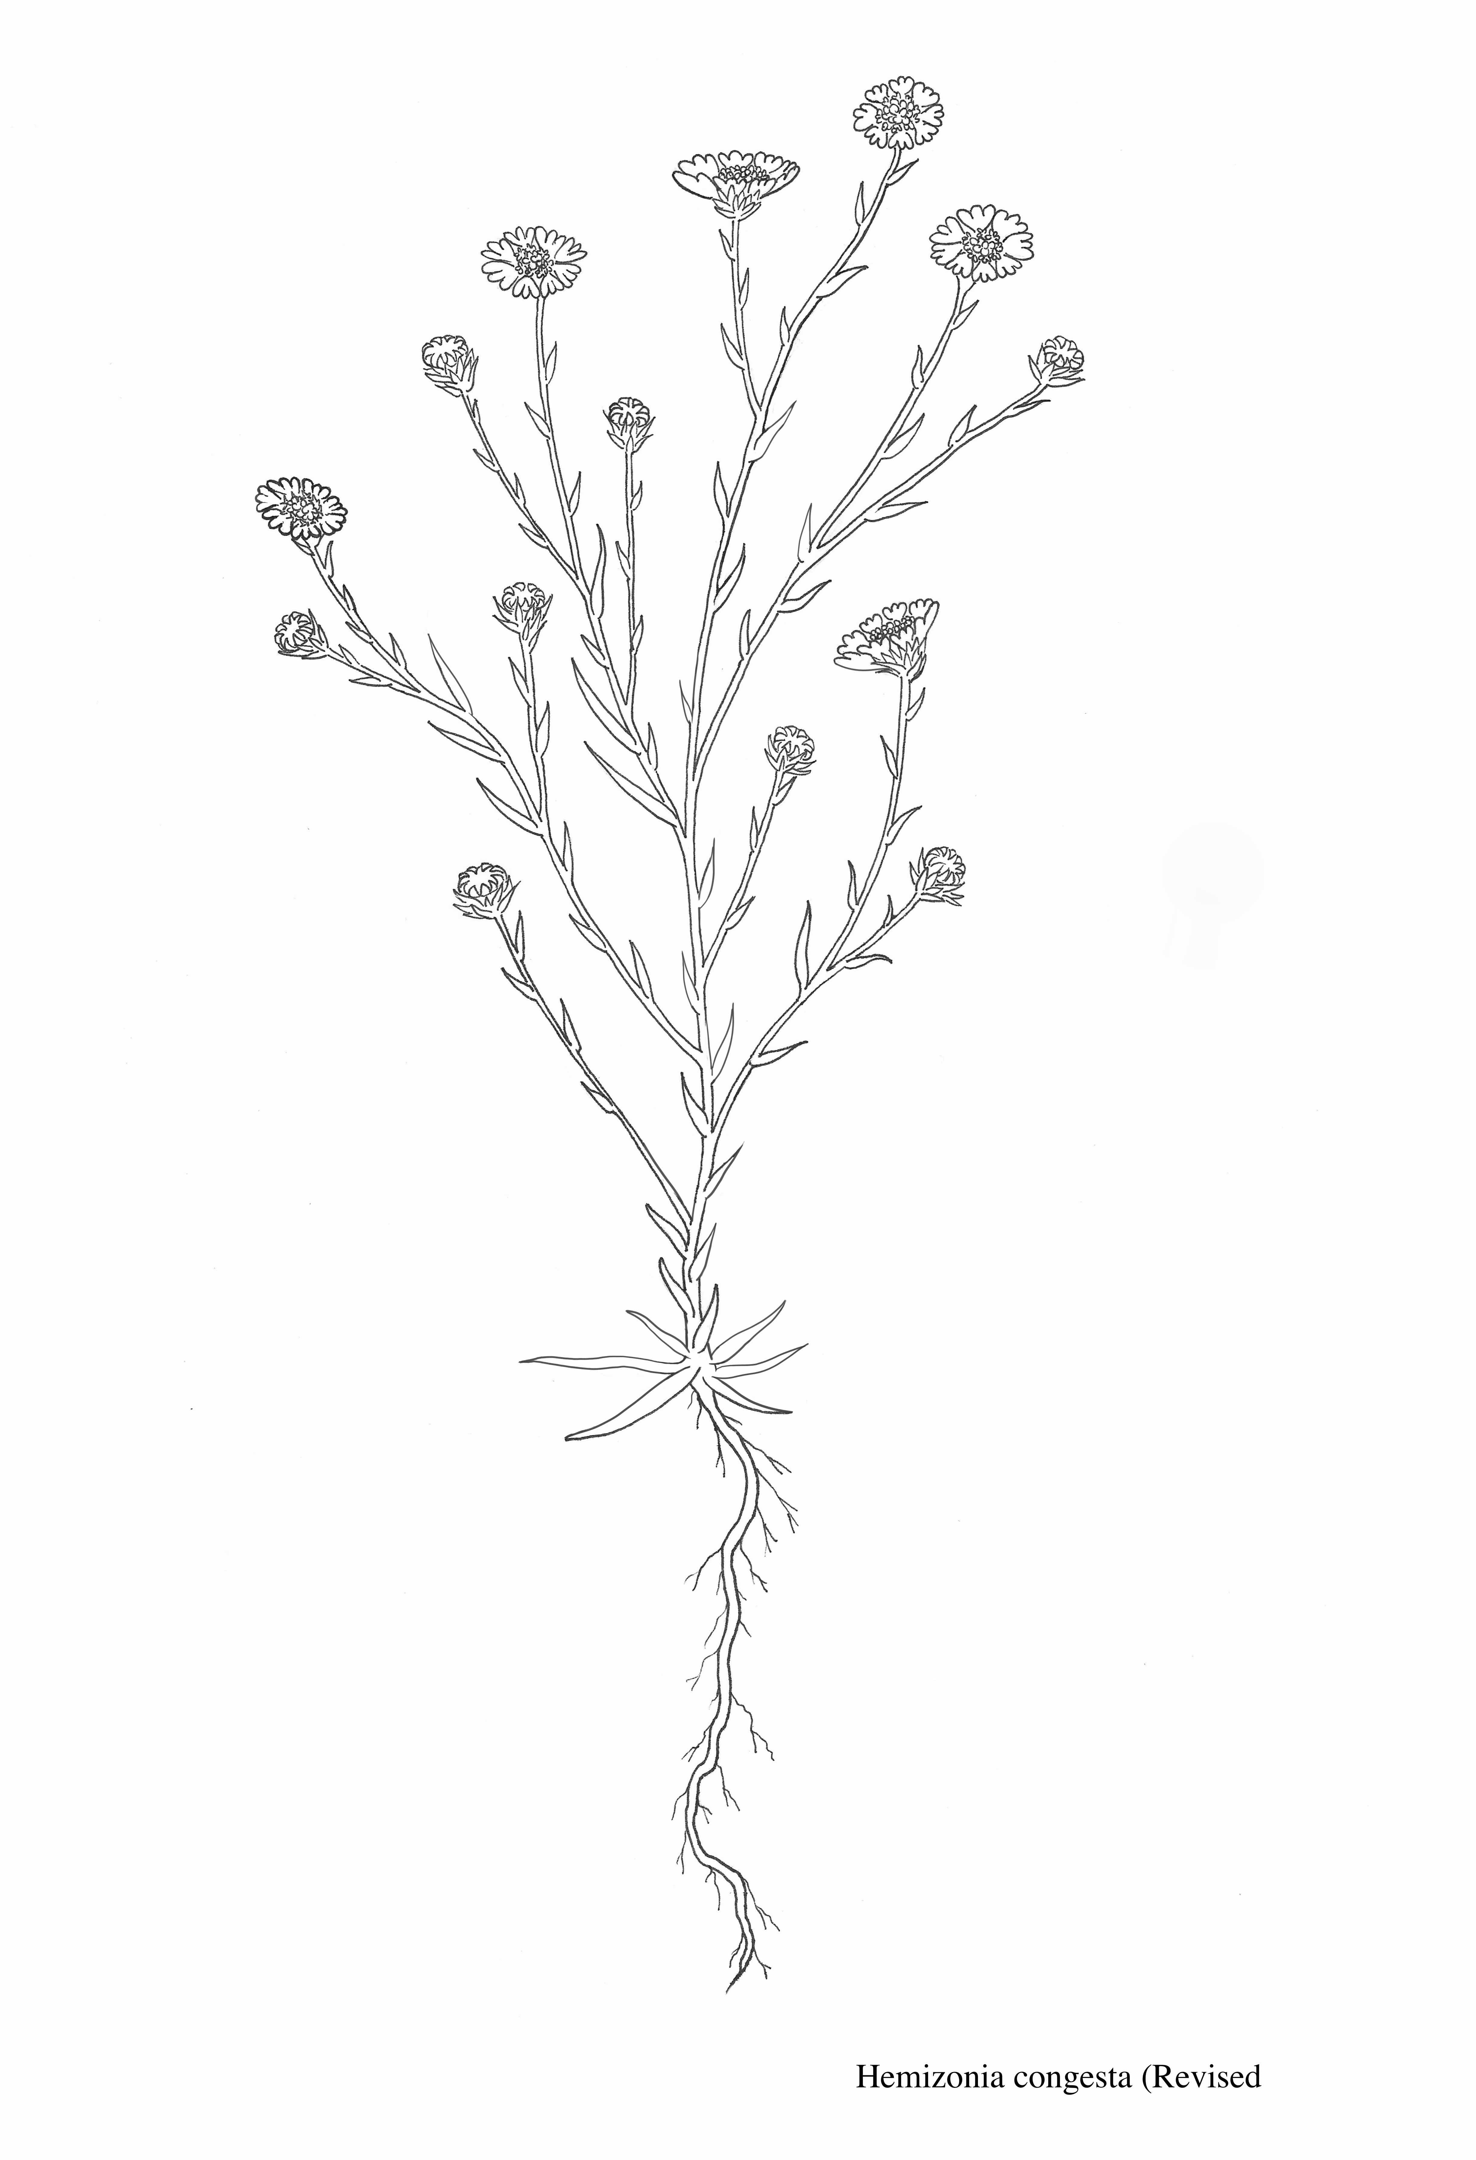
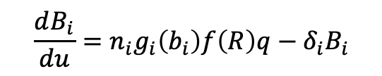
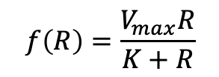
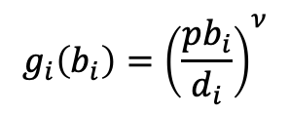
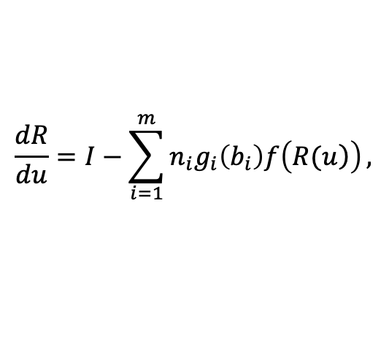
Simulation model
Plant Biomass B(u)
$${\frac{dB_{i}}{du}=n}_{i}g_{i}\left(b_{i}\right)f\left(R\right)q−δ_{i}B_{i}$$
Root allocation
$$g_{i}\left(b_{i}\right)={\left(\frac{pb_{i}}{d_{i}}\right)}^{ν}$$
$$f\left(R\right)=\frac{V_{max}R}{K+R}$$
Soil Resources
R(u)
$$\frac{dR}{du}=I−\sum_{i=1}^{m}{n_{i}g_{i}\left(b_{i}\right)f\left(\left.R(u\right)\right)},$$
Notes:
So created a simulation model that captures some of these dynamics.
It explicitly tracks a single resource, which you could imagine is soil moisture. In this figure on the right you can see the resource is continually declining throughout the year.
Plants draw that resource down over time and it is never replenished--reflecting the lack of spring and summer rain in this system.
Plant growth, is shown in this lower figure on the right. You can see the growth trajectories of three different species shown in different colors. Species one is the earliest species shown in black, species two shown in red grows a little later into the season, and species three is the latest growing species shown in blue.
The differences in phenology and growth shown by these species are entirely due to just two parameters in the model, they have different maximum growth rates, r and different resource have saturation constants K.
Growth is given by this piecewise function shown here, where resource concentrations are great enough to ensure positive growth for that species the species grows, but when resource concentrations get below a certain level, then the growth can no longer be positive and I set growth to zero.
This determines the end point of each species growing season, at this point each species will reach it’s maximum biomass, and I make the assumption that this biomass is converted by some conversion function to seeds for the next year.

Slide 15
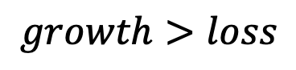
Simulation model
$$growth>loss$$
Soil Resources
R(u)
Notes:
So created a simulation model that captures some of these dynamics.
It explicitly tracks a single resource, which you could imagine is soil moisture. In this figure on the right you can see the resource is continually declining throughout the year.
Plants draw that resource down over time and it is never replenished--reflecting the lack of spring and summer rain in this system.
Plant growth, is shown in this lower figure on the right. You can see the growth trajectories of three different species shown in different colors. Species one is the earliest species shown in black, species two shown in red grows a little later into the season, and species three is the latest growing species shown in blue.
The differences in phenology and growth shown by these species are entirely due to just two parameters in the model, they have different maximum growth rates, r and different resource have saturation constants K.
Growth is given by this piecewise function shown here, where resource concentrations are great enough to ensure positive growth for that species the species grows, but when resource concentrations get below a certain level, then the growth can no longer be positive and I set growth to zero.
This determines the end point of each species growing season, at this point each species will reach it’s maximum biomass, and I make the assumption that this biomass is converted by some conversion function to seeds for the next year.

Slide 16
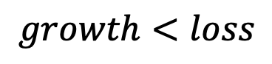
Simulation model
$$growth<loss$$
Stop Growing!
Soil Resources
R(u)
Notes:
So created a simulation model that captures some of these dynamics.
It explicitly tracks a single resource, which you could imagine is soil moisture. In this figure on the right you can see the resource is continually declining throughout the year.
Plants draw that resource down over time and it is never replenished--reflecting the lack of spring and summer rain in this system.
Plant growth, is shown in this lower figure on the right. You can see the growth trajectories of three different species shown in different colors. Species one is the earliest species shown in black, species two shown in red grows a little later into the season, and species three is the latest growing species shown in blue.
The differences in phenology and growth shown by these species are entirely due to just two parameters in the model, they have different maximum growth rates, r and different resource have saturation constants K.
Growth is given by this piecewise function shown here, where resource concentrations are great enough to ensure positive growth for that species the species grows, but when resource concentrations get below a certain level, then the growth can no longer be positive and I set growth to zero.
This determines the end point of each species growing season, at this point each species will reach it’s maximum biomass, and I make the assumption that this biomass is converted by some conversion function to seeds for the next year.

Slide 17
Simulation model
$$growth<loss$$
Stop Growing!
Make Seeds!
Soil Resources
R(u)
Notes:
So created a simulation model that captures some of these dynamics.
It explicitly tracks a single resource, which you could imagine is soil moisture. In this figure on the right you can see the resource is continually declining throughout the year.
Plants draw that resource down over time and it is never replenished--reflecting the lack of spring and summer rain in this system.
Plant growth, is shown in this lower figure on the right. You can see the growth trajectories of three different species shown in different colors. Species one is the earliest species shown in black, species two shown in red grows a little later into the season, and species three is the latest growing species shown in blue.
The differences in phenology and growth shown by these species are entirely due to just two parameters in the model, they have different maximum growth rates, r and different resource have saturation constants K.
Growth is given by this piecewise function shown here, where resource concentrations are great enough to ensure positive growth for that species the species grows, but when resource concentrations get below a certain level, then the growth can no longer be positive and I set growth to zero.
This determines the end point of each species growing season, at this point each species will reach it’s maximum biomass, and I make the assumption that this biomass is converted by some conversion function to seeds for the next year.

Slide 18
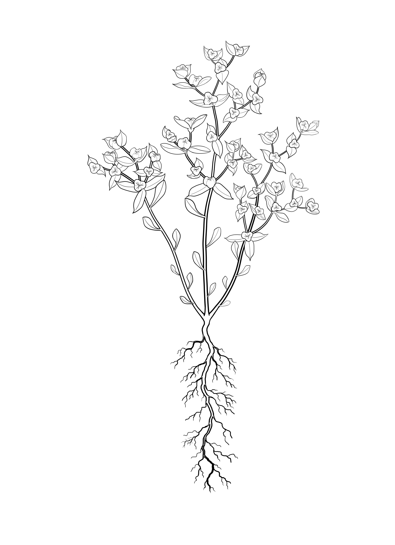
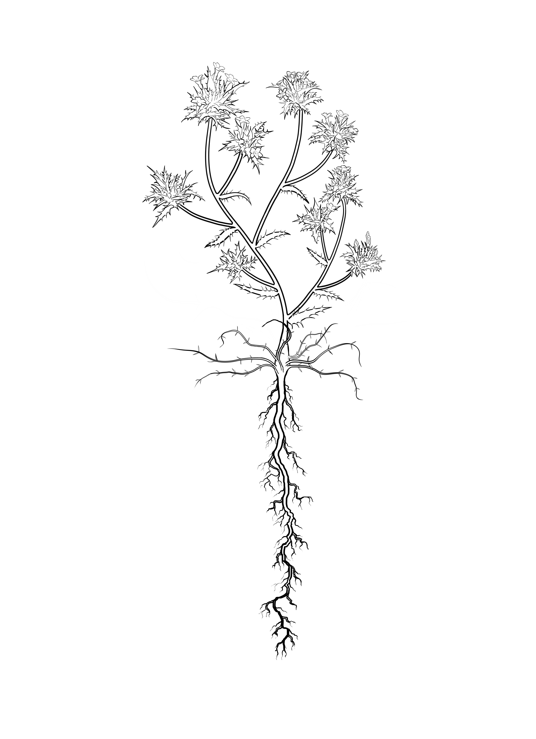
Species differences
early
middle
late
Low root density
High root density
Notes:
Just to get a better idea of how these species differences come about, you can see that species one, the black curve has the fastest maximum growth rate but it’s growth rate declines most rapidly as the resource level is reduced.
Species three on the other hand, shown in blue, is like a very late season species, it has the slowest maximum growth rate but it is able to keep growing at very low resource levels.
Species two is somewhere between the two.

Slide 19
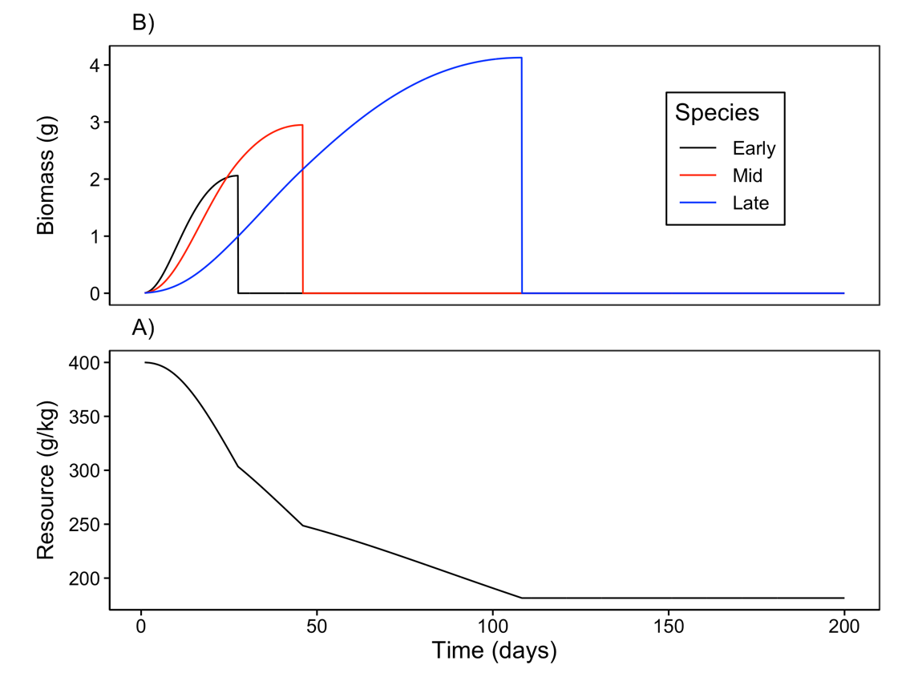
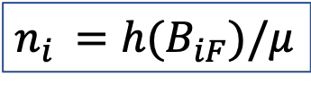
Simulation Model
Convert Biomass
$$n_{i }=h(B_{iF})/μ$$
Seeds
Notes:
So created a simulation model that captures some of these dynamics.
It explicitly tracks a single resource, which you could imagine is soil moisture. In this figure on the right you can see the resource is continually declining throughout the year.
Plants draw that resource down over time and it is never replenished--reflecting the lack of spring and summer rain in this system.
Plant growth, is shown in this lower figure on the right. You can see the growth trajectories of three different species shown in different colors. Species one is the earliest species shown in black, species two shown in red grows a little later into the season, and species three is the latest growing species shown in blue.
The differences in phenology and growth shown by these species are entirely due to just two parameters in the model, they have different maximum growth rates, r and different resource have saturation constants K.
Growth is given by this piecewise function shown here, where resource concentrations are great enough to ensure positive growth for that species the species grows, but when resource concentrations get below a certain level, then the growth can no longer be positive and I set growth to zero.
This determines the end point of each species growing season, at this point each species will reach it’s maximum biomass, and I make the assumption that this biomass is converted by some conversion function to seeds for the next year.

Slide 20
Competition “Experiment”
Focal species
Density of each competitor
0, 16 |  |  | 16,16
0,8
0,2
0, 0 | 2,0 | 8,0 | 16, 0
Competitor two
Count seeds at end of season
Competitor one

Slide 21
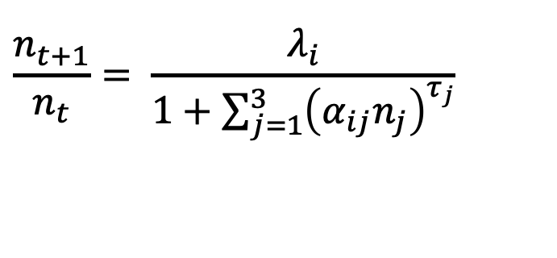
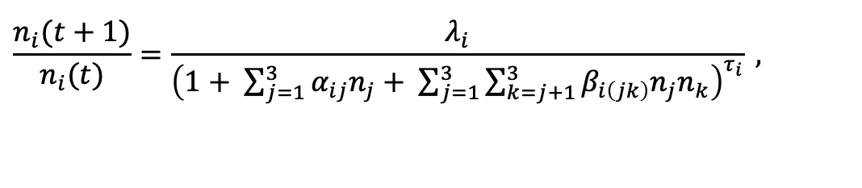
Competition Models
Fit two competition models to the simulated data
$$\frac{n_{t+1}}{n_{t}}= \frac{λ_{i}}{1+\sum_{j=1}^{3}{{\left(α_{ij}n_{j}\right)}^{τ_{j}}}}$$
“Hassel Model” No HOIs
$$\frac{n_{i}(t+1)}{n_{i}(t)}=\frac{λ_{i}}{{\left(1+ \sum_{j=1}^{3}{α_{ij}n_{j}}+ \sum_{j=1}^{3}{\sum_{k=j+1}^{3}{β_{i\left(jk\right)}n_{j}n_{k}}}\right)}^{τ_{i}}} ,$$
With HOIs
Notes:
Ok so what do the competitive effects look like in this system.
On the x-axis of each figure is the starting density of a competing species, either one, two or three. These numbers represent the number of seeds, or the number of individuals of the each competitor species in the system. On the y-axis is the per-capita fecundity of species one, two and and three. Figure one is shown on the left, two in the middle and three on the right.
Now I want to make this part really clear, the dots are showing the simulated per capita fecundity from the mechanistic model I just described.
Here on the left you see the response of species one two the density of species three (shown in blue), species two, shown in red, species one shown in black in so on.
The lines are the fitted response produced by an pairwise competition model of this form shown up here. This is a modified Beverton holt model similar to the annual plant model that is commonly used in Peter Chesson and Jonathan Levine’s work.
The take home here is that this pairwise model, the lines, fits the points, the simulations, really well. The pairwise model, accurately captures the effects of competition in this system.
So the big question here is how will this pairwise model hold up when we move to a multispecies situation? That is for example, if simulate a case where species one is facing competition from species two and species three together, can we assume that these pairwise effects are additive? Or are their higher order interactions between two and three that make make multi-species competition non-additive?

Slide 22
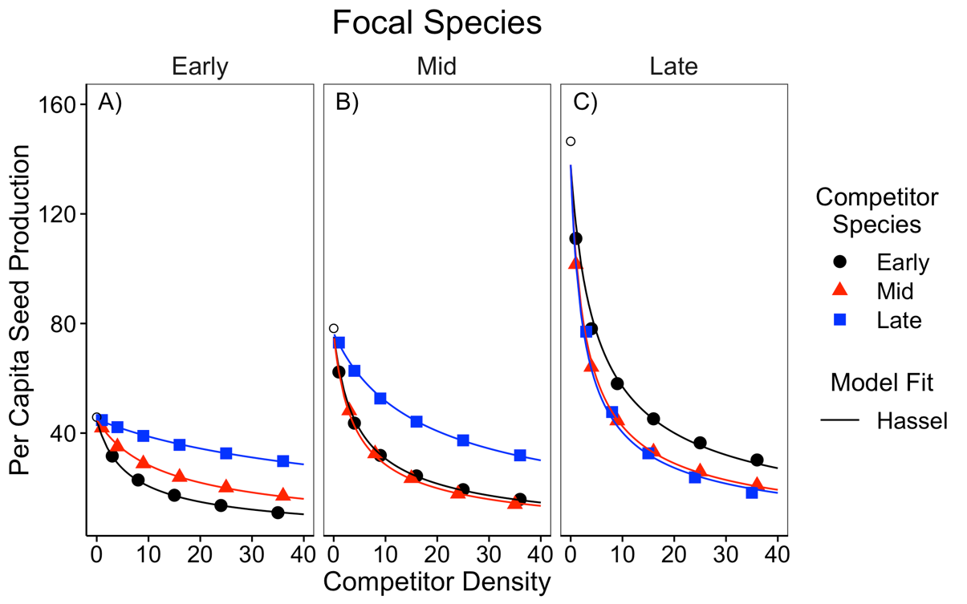
One Competitor at a Time
Notes:
Ok so what do the competitive effects look like in this system.
On the x-axis of each figure is the starting density of a competing species, either one, two or three. These numbers represent the number of seeds, or the number of individuals of the each competitor species in the system. On the y-axis is the per-capita fecundity of species one, two and and three. Figure one is shown on the left, two in the middle and three on the right.
Now I want to make this part really clear, the dots are showing the simulated per capita fecundity from the mechanistic model I just described.
Here on the left you see the response of species one two the density of species three (shown in blue), species two, shown in red, species one shown in black in so on.
The lines are the fitted response produced by an pairwise competition model of this form shown up here. This is a modified Beverton holt model similar to the annual plant model that is commonly used in Peter Chesson and Jonathan Levine’s work.
The take home here is that this pairwise model, the lines, fits the points, the simulations, really well. The pairwise model, accurately captures the effects of competition in this system.
So the big question here is how will this pairwise model hold up when we move to a multispecies situation? That is for example, if simulate a case where species one is facing competition from species two and species three together, can we assume that these pairwise effects are additive? Or are their higher order interactions between two and three that make make multi-species competition non-additive?

Slide 23
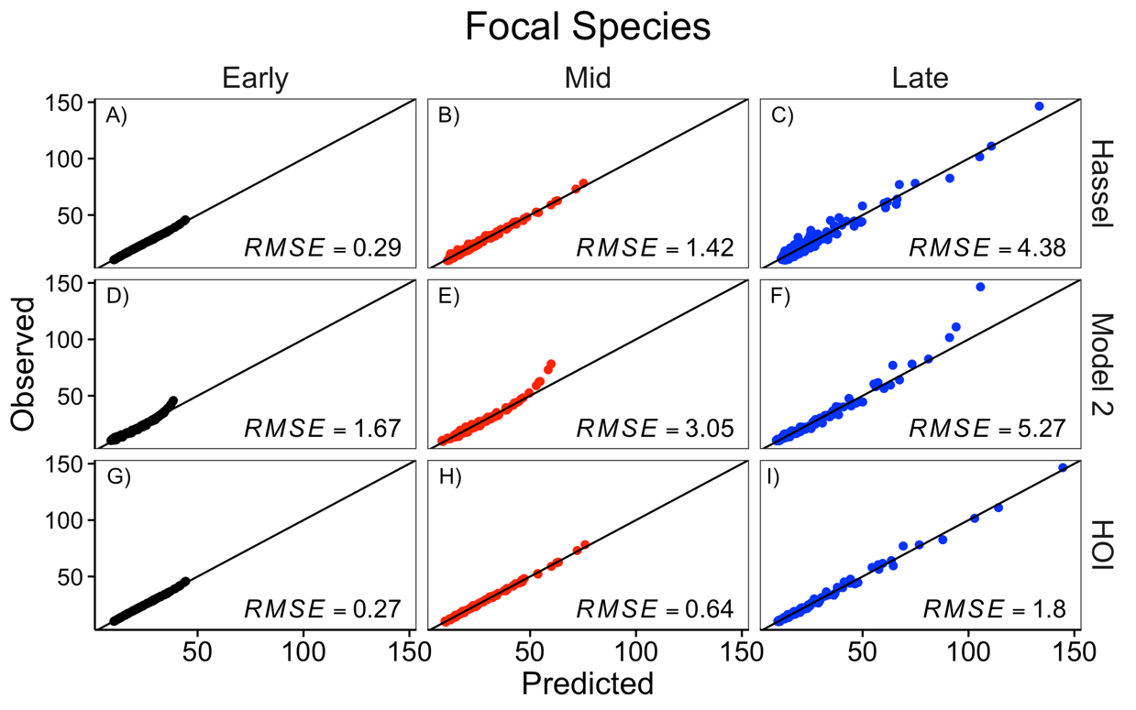
Two Competitors at Once?
Model
No HOIs
With HOIs
Notes:
Ok so what do the competitive effects look like in this system.
On the x-axis of each figure is the starting density of a competing species, either one, two or three. These numbers represent the number of seeds, or the number of individuals of the each competitor species in the system. On the y-axis is the per-capita fecundity of species one, two and and three. Figure one is shown on the left, two in the middle and three on the right.
Now I want to make this part really clear, the dots are showing the simulated per capita fecundity from the mechanistic model I just described.
Here on the left you see the response of species one two the density of species three (shown in blue), species two, shown in red, species one shown in black in so on.
The lines are the fitted response produced by an pairwise competition model of this form shown up here. This is a modified Beverton holt model similar to the annual plant model that is commonly used in Peter Chesson and Jonathan Levine’s work.
The take home here is that this pairwise model, the lines, fits the points, the simulations, really well. The pairwise model, accurately captures the effects of competition in this system.
So the big question here is how will this pairwise model hold up when we move to a multispecies situation? That is for example, if simulate a case where species one is facing competition from species two and species three together, can we assume that these pairwise effects are additive? Or are their higher order interactions between two and three that make make multi-species competition non-additive?

Slide 24
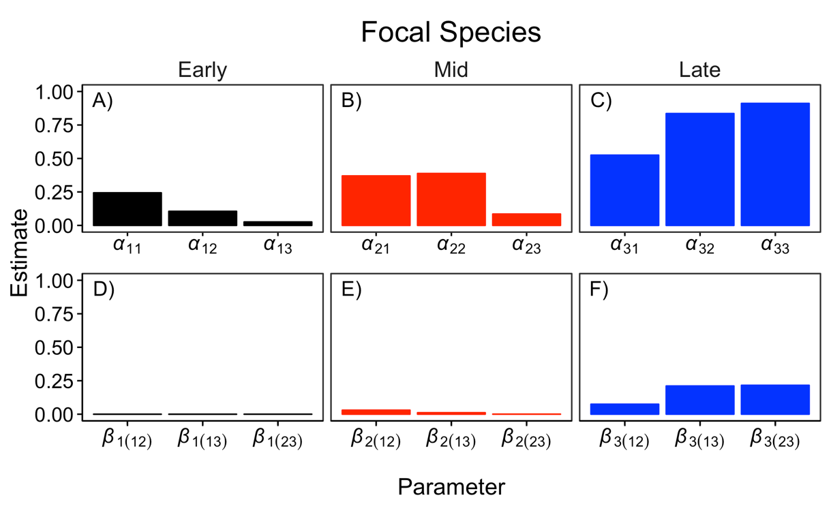
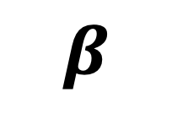
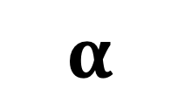
Strength of HOIs
$$α$$
$$β$$
Notes:
Ok so what do the competitive effects look like in this system.
On the x-axis of each figure is the starting density of a competing species, either one, two or three. These numbers represent the number of seeds, or the number of individuals of the each competitor species in the system. On the y-axis is the per-capita fecundity of species one, two and and three. Figure one is shown on the left, two in the middle and three on the right.
Now I want to make this part really clear, the dots are showing the simulated per capita fecundity from the mechanistic model I just described.
Here on the left you see the response of species one two the density of species three (shown in blue), species two, shown in red, species one shown in black in so on.
The lines are the fitted response produced by an pairwise competition model of this form shown up here. This is a modified Beverton holt model similar to the annual plant model that is commonly used in Peter Chesson and Jonathan Levine’s work.
The take home here is that this pairwise model, the lines, fits the points, the simulations, really well. The pairwise model, accurately captures the effects of competition in this system.
So the big question here is how will this pairwise model hold up when we move to a multispecies situation? That is for example, if simulate a case where species one is facing competition from species two and species three together, can we assume that these pairwise effects are additive? Or are their higher order interactions between two and three that make make multi-species competition non-additive?

Slide 25
Questions
What counts as an HOI really?
Provide a new general definition of HOIs
How might HOIs arise in nature?
Simulate plant competition and fit HOI model
Notes:
Since, there is are so few empirical data to work with, our approach here was to first
Simulate some artificial plant communities using a mechanistic but very simplified model of species competition, that assumes nothing about higher order interactions.
Fit additive competition models to all the simulations involving pairwise competition.
Using the fitted additive competition models, we will then predict the effects of multispecies competition.
Finally we can evaluate the presence of higher order interactions by comparing the response to competition predicted by the additive models to the response “observed” in the simulation

Slide 26
What causes higher order interactions?
Differences in timing of growth and resource use
NO HOIs
Weak HOIs
Strong HOIs
Notes:
I think the key to understanding this is that each species in this system has different timing of growth and resource use. Each species grows most rapidly at a different time, and earlier species, stop growing and competing once they flower.
You can break the growing season up into sections,
In phase one, all the species are actively growing and competing,
In phase two its just two and three,
and then in phase three it’s just species three alone.

Slide 27
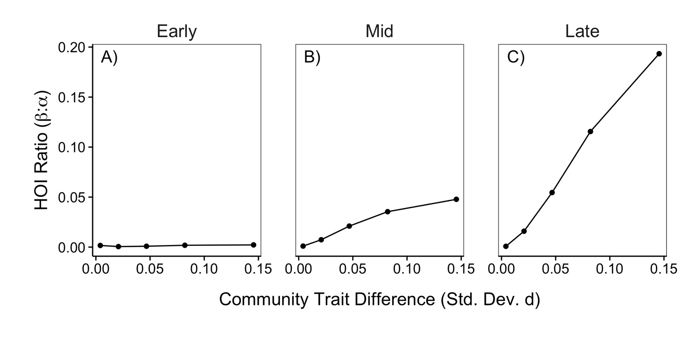
What causes higher order interactions?
Larger trait differences lead to greater HOIs
Strength of HOIs
Notes:
To see how this might lead to higher order interactions, consider here how competition affects species three throughout the course of the growing season.
You start out with all three species active

Slide 28
Conclusions
Study of HOIs in nature requires a shared definition among research labs!
Differences in timing of growth may lead to HOIs
Larger HOIs emerge for later season species and when trait differences are larger
Notes:
Ok so hopefully that wasn’t too confusing. But it’s hard to explain these things.
Some take home messages for this session:
First we can detect higher order interactions only if we have models that accurately predict pairwise dynamics.
Second, our very simple single resource simulations suggest that higher order interactions can emerge in discrete time models when we are dealing with plants that differ in their timing of growth and competition. I think this scenario is probably really common in nature and so I would not be surprised if some higher order interactions are common in plant communities

Slide 29

Acknowledgements
Kraft Lab:
Mary Van Dyke
Suzanne Ou
Guarav Kandlikar
Ian McFadden
Notes:
I’d like to thank the kraft lab and funding from NSF and UCLA for this research.

